Slide 1
Implementation Diagram and Quiz
Session 26
(Tutorial)
Course : Program Design Methods
Effective Period : July 2018

Slide 2
These slides have been adapted from
Britton, C.. (2005). A student Guide to Object Oriented Development. 01. Butterworth-Heinemann. Amsterdam. ISBN: 978-0-7506-6123-2. Chapter 9
Acknowledgement

Slide 3
LO 5 : Explain the object oriented design
Learning Objectives

Slide 4
Contents
Architecture
Implementation Diagrams
The user interface
Dealing with persistence data
Quiz

Slide 5
Architecture
The architecture of a system will be consists of software and hardware components of the system.
The software components can be described logically in terms of classes, packages, subsystems, and their dependencies , or physically in terms of executable files, class libraries and databases
Hardware architecture, from the system developer’s perspective is concerned with the computers, peripherals and networks on which the system will run

Slide 6
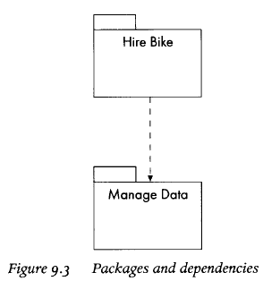
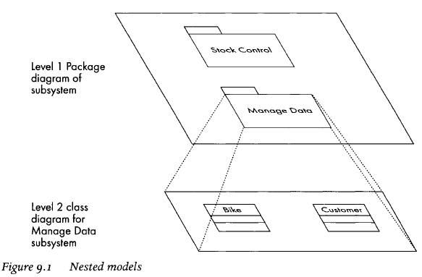
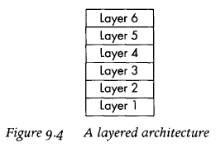
Architecture System

Slide 7
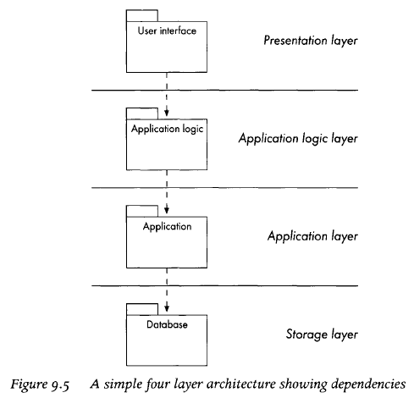
Simple Architecture Layer

Slide 8
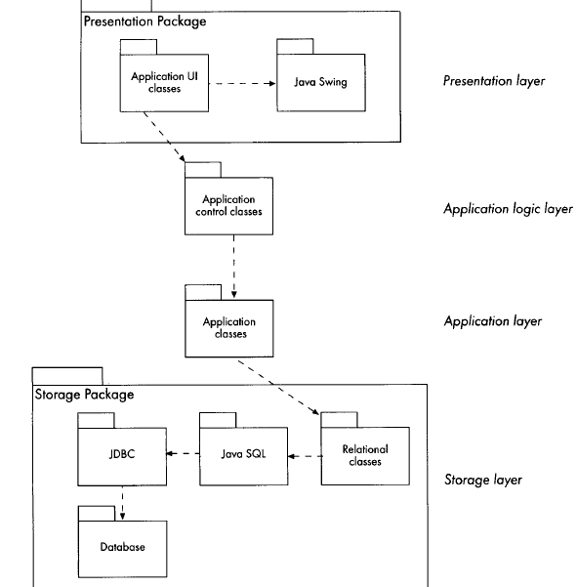
Architecture Package Layer

Slide 9
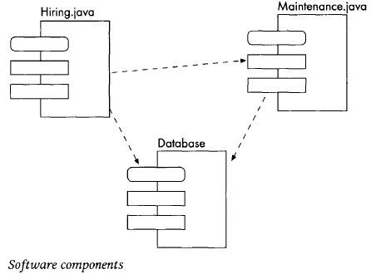
Component Diagram
The components of a system often correspond to packages, but this is not necessarily the case, as components represent physical software files and the packages identified in design are logical units. Wheels, the code for the whole system might be put in a single source file, or we might divide it into two subsystem files and a database file

Slide 10
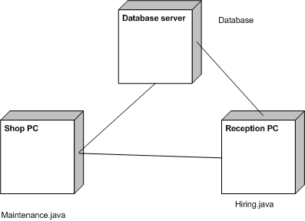
Deployment diagram
Deployment diagrams show the physical arrangement of the hardware elements of computer system
Example : deployment diagram showing a hardware configuration for the Wheels system

Slide 11
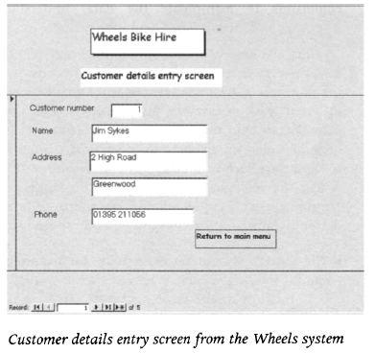
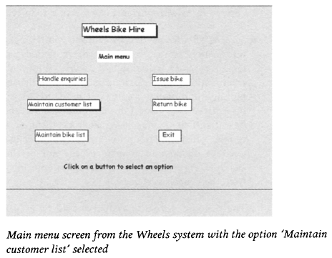
The user interface

Slide 12
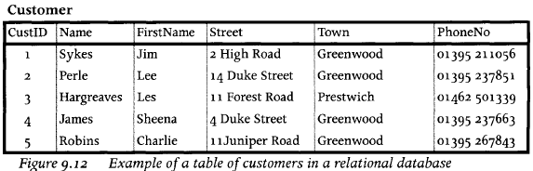
Dealing with persistent data
Linking an object-oriented program to a relational database

Slide 13
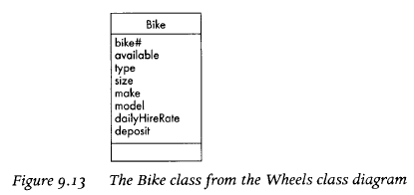
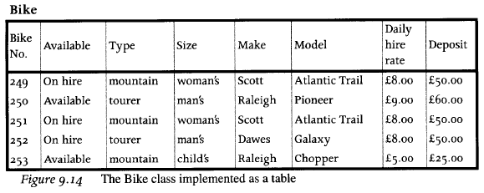
Implementing association relationship in a relational database

Slide 14
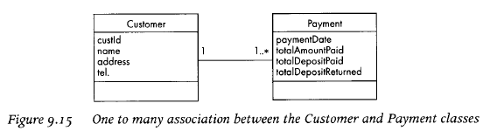
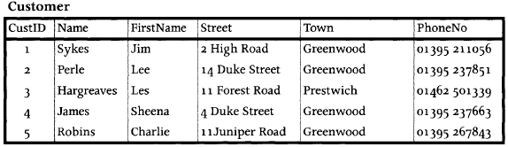
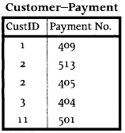
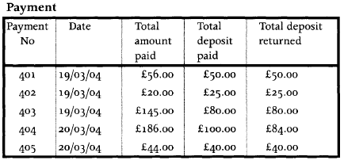
Implementing association relationship in a relational database

Slide 15
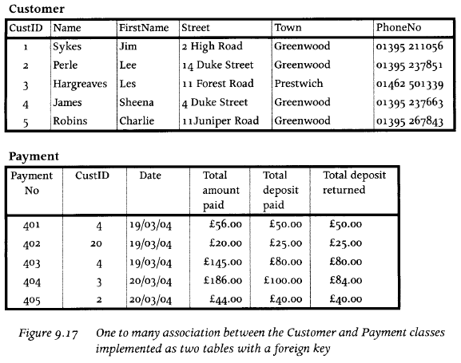
Implementing association relationship in a relational database

Slide 16
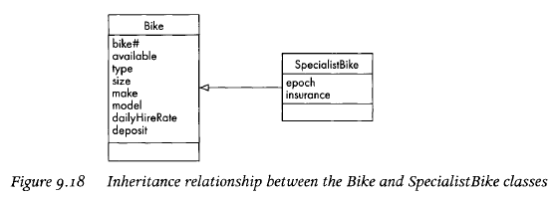
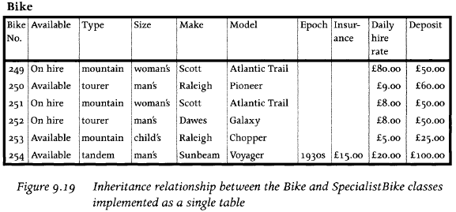
Implementing association relationship in a relational database

Slide 17
Implementation Diagram
Component diagrams. The UML has two kinds of implementation diagrams: component diagrams and deployment diagrams

Slide 18
References
Britton, C.. (2005). A student Guide to Object Oriented Development. 01. Butterworth-Heinemann. Amsterdam. ISBN: 978-0-7506-6123-2.
Deployment Diagram, http://www.agilemodeling.com/artifacts/deploymentDiagram.htm
Component Diagram, http://www.tutorialspoint.com/uml/uml_component_diagram.htm
Deployment Diagram, http://www.tutorialspoint.com/uml/uml_deployment_diagram.htm

Slide 19
Q & A

Slide 20
Quiz II

